Slide 1







STUDENT GADGET REGISTRATION
MANAGEMENT SYSTEM
DATABASE DESIGN & IMPLEMENTATION • COSC 333 Dr Izang
Adeniran Anjolaoluwa Al-Ameen
22/0575
Alabo Treasure Sowari
22/2858
Adeyemi Ademola Roland
22/0539
Osobase Joseph Beloved
21/2685
Eze-Walter Kingsley
Chuku Michael Azunda
22/2955
22/2033
01

Slide 2



Project Overview
We built a comprehensive Asset Tracking Platform designed to centralize the management of student-owned electronic devices and streamline incident reporting.
MySQL 8.0
Node.js API
Secure Design
Robust relational database engine ensuring 3NF compliance.
High-performance backend handling asynchronous logic.
JWT Authentication and Input Sanitization.
02

Slide 3



The Problem: Manual Inefficiency
Current campus security relies on paper-based logs or disconnected spreadsheets.
Data Redundancy: Same student details repeated hundreds of times.
Slow Retrieval: Searching for a stolen laptop serial number takes hours.
No Validation: Impossible to verify if a serial number is unique or valid.
03

Slide 4



Objectives & Scope
Centralization
Asset Tracking
Analytics
Create a unified repository for all student device data, accessible by authorized security personnel.
Monitor the lifecycle of a device from initial registration to potential incident reporting.
Provide administrative dashboards for real-time visualization of gadget distribution.
04

Slide 5

Business Rules
The integrity of the system relies on four non-negotiable constraints:
1. Unique Identity
Gadgets must use Serial Number/IMEI as unique identifiers.
2. Mandatory Ownership
No orphan gadgets; every device links to a registered Student.
3. Academic Structure
Students map to Departments for organizational analytics.
05

Slide 6
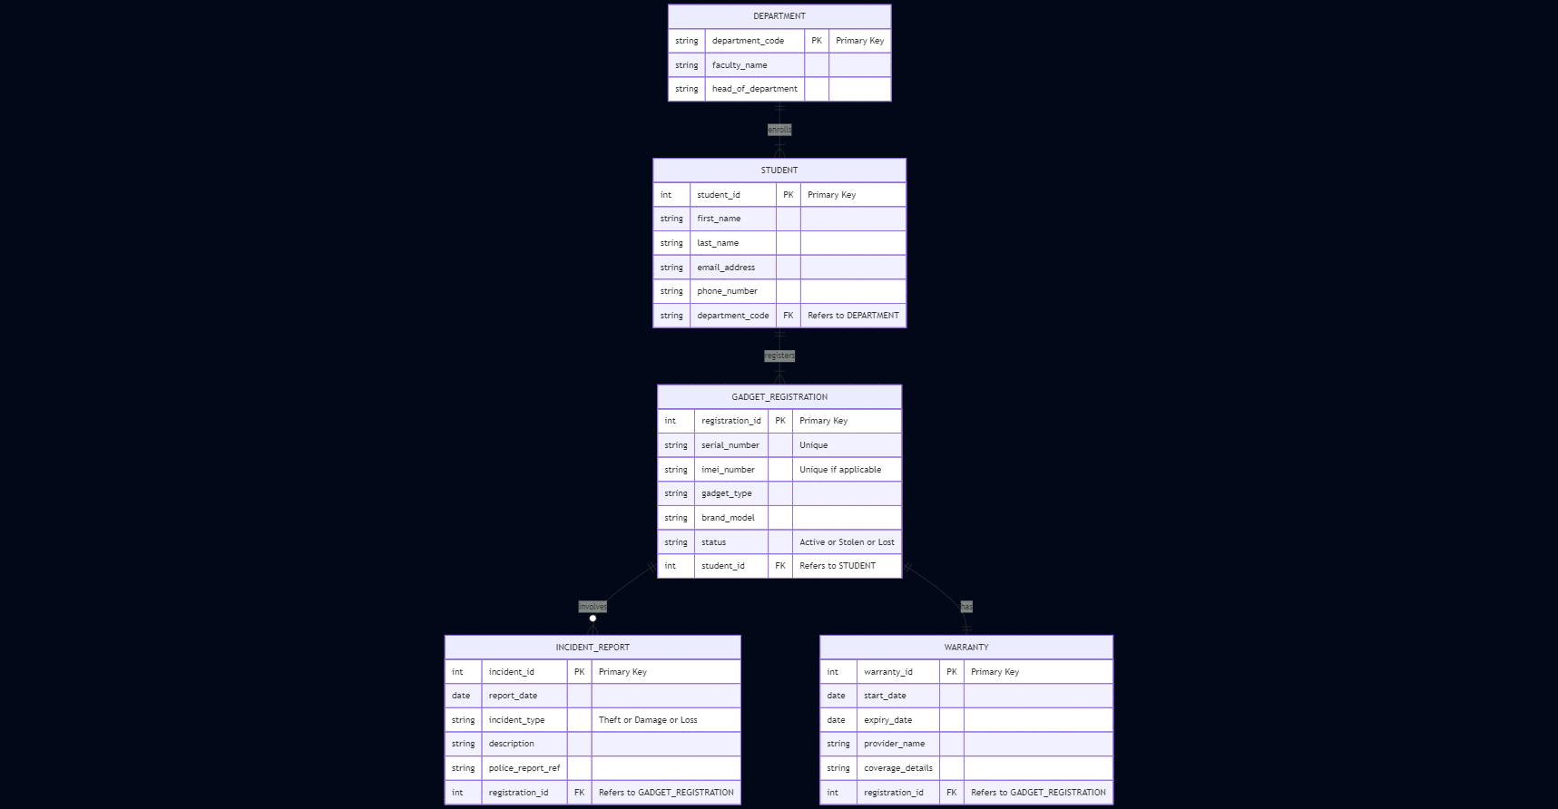
Conceptual Design (ERD)
The blueprint for our relational model.
06

Slide 7


Logical Design & Normalization
3NF Transitive Removal
1NF & 2NF Compliance
We identified that Department_Name depended on Dept_Code, not the Student.
We enforced atomicity by splitting student names and ensuring all non-key attributes (like Gadget Brand) depend fully on the Primary Key.
Action: Extracted Department data into a separate lookup table.
07

Slide 8
Final Schema
Table Entity | PK / FK Structure | Description
DEPARTMENT | dept_code | Lookup for academic units.
STUDENT | student_id, FK: dept_code | Core user profile data.
GADGET | reg_id, FK: student_id | Device specs. Serial is UNIQUE.
INCIDENT | inc_id, FK: reg_id | Tracks theft/damage events.
INSURANCE | ins_id, FK: reg_id | 1:1 Policy details.
08

Slide 9
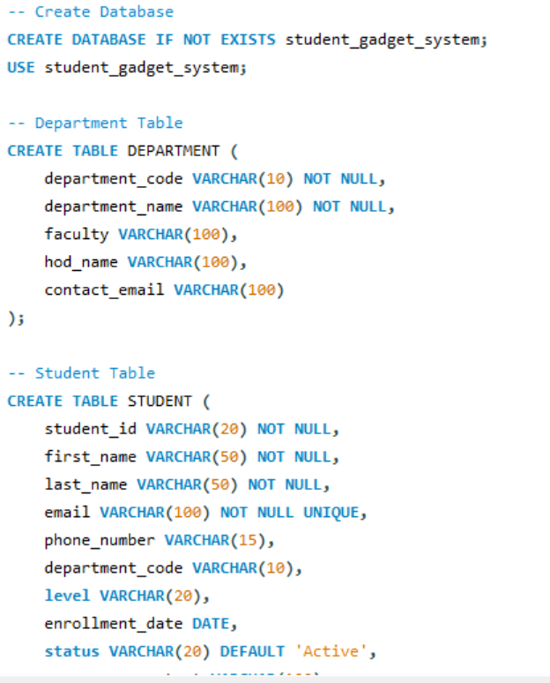
Physical Implementation
Implemented using MySQL 8.0 with InnoDB engine for ACID compliance.
•
CREATE TABLE structure definitions.
•
ALTER TABLE for foreign key constraints.
•
INSERT INTO 50+ dummy records.
09

Slide 10





Technology Stack
HTML5 / CSS3
Node.js
Express.js
MySQL
Frontend UI
Runtime
API Framework
Database
10

Slide 11
Security Implementation
Input Sanitization
Credential Protection
CORS Policy
Express-Validator middleware prevents SQL Injection on all forms.
Database configs isolated in environment variables, never hardcoded.
Strict API access control restricting requests to authorized domains only.
11

Slide 12

REST API Architecture
We designed a RESTful API to handle client-server communication.
GET /api/students List all students
POST /api/students Register new user
POST /api/gadgets Register device
GET /api/incidents/stats Admin Dashboard
12

Slide 13


Frontend & User Interface
Student Registration
Incident Reporting
Validates unique emails and department codes via AJAX before submission.
Dynamic dropdowns ensure students can only report incidents for gadgets they actually own.
13

Slide 14



Challenges & Resolutions
Normalization
Async Logic
Double Entry
Challenge: Linking Incidents without circular dependencies.
Fix: Direct FK to Gadget ID only.
Challenge: Node.js non-blocking queries.
Fix: Implemented async/await pattern.
Challenge: Shared device registration.
Fix: Hardware-level UNIQUE index on Serial.
14

Slide 15
PROJECT SUCCESS
We successfully delivered a robust, 3NF-compliant relational database system. The SGRMS application meets all requirements for secure asset tracking and incident management.
15

Slide 16
QUESTIONS?
THANK YOU
16

